Slide 1


Examining H1B Data Group 3
Cory Nguyen, Cuiting Zhong, Kirti Pande, Ryan Hoff, Sagar Chadha
Notes:
ryan

Slide 2

Have you applied for an H1B visa for the United States and want to know if you will get it??
✓ Our Team of Machine Learning Experts has a way to help!
“If we predict ‘Certified’, you can be 99% sure of getting the visa.
If we predict ‘Denied’, you can be 98% sure of not getting it.”
Notes:
ryan

Slide 3


Our Data
“The main objective is to give, with as much accuracy as possible, the chance of denial to an applicant.”
Our Vision
500,000 rows of visa applications to the US from 2011 – 2017
Predictor variables - job applied for, wage offered, submission day, decision day, etc.
“Status" is categorical and has two possible values – ‘Certified’ and ‘Denied’
Tell with absolute certainty that an application would be certified.
× Predict with high confidence when an application would be denied.
Notes:
ryan

Slide 4
Exploratory Data Analysis

Slide 5
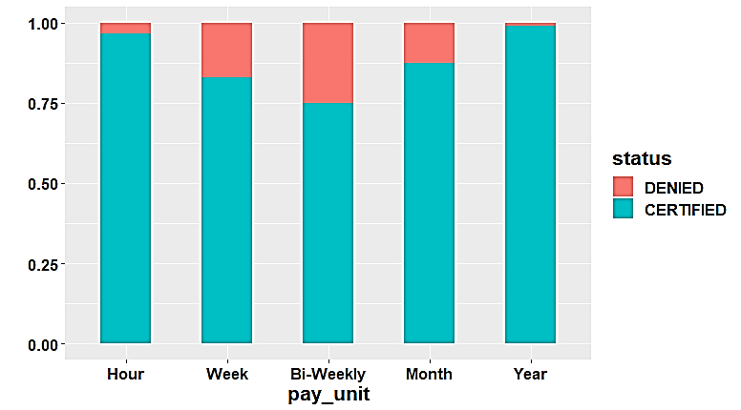
Hypothesis Generation
Validation
Important Predictors | Insight
Pay Unit of the job | More likely to reject applications for ad-hoc jobs
Wage | Applications for high paying jobs should be certified more easily
Submission/Decision | Tendency to deny more for lean application periods
Waiting times for the decision | Rejections should be much quicker than certifications
Job Function Group | Certification depends on the job function that the person applies for.
Unit of Pay vs Denial Rate
Notes:
sagar

Slide 6
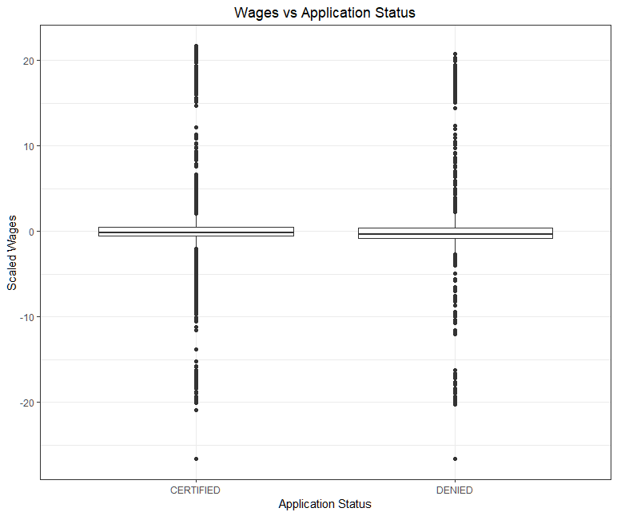
Hypothesis Generation
Validation
Important Predictors | Insight
Pay Unit of the job | More likely to reject applications for ad-hoc jobs
Wage | Applications for high paying jobs should be certified more easily
Submission/Decision | Tendency to deny more for lean application periods
Waiting times for the decision | Rejections should be much quicker than certifications
Job Function Group | Certification depends on the job function that the person applies for.
Notes:
sagar

Slide 7
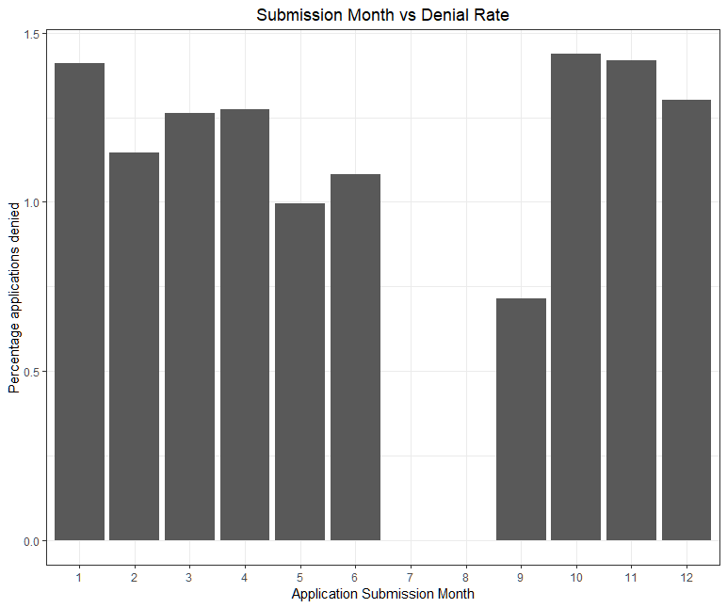
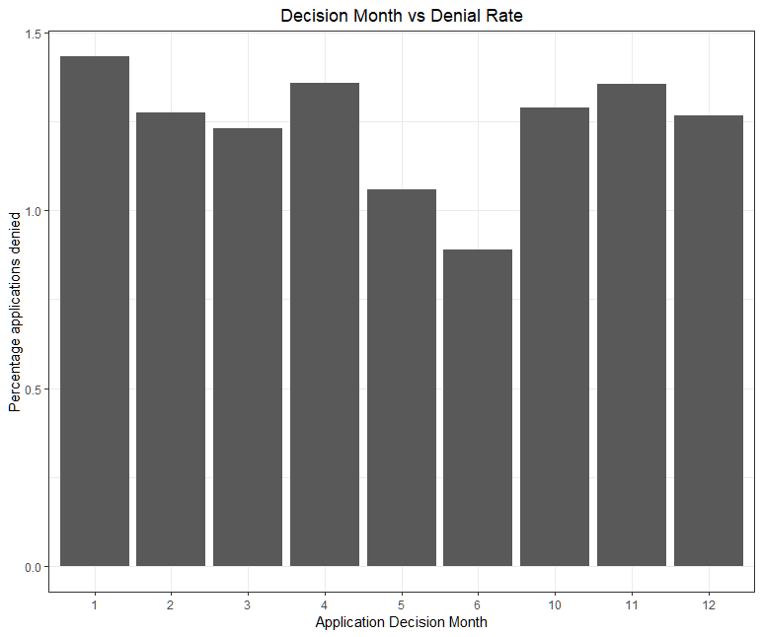
Hypothesis Generation
Validation
Submission Month vs Denial Rate
Important Predictors | Insight
Pay Unit of the job | More likely to reject applications for ad-hoc jobs
Wage | Applications for high paying jobs should be certified more easily
Submission/Decision | Dependence on when the application was submitted or decided upon
Waiting times for the decision | Rejections should be much quicker than certifications
Job Function Group | Certification depends on the job function that the person applies for.
Decision Month vs Denial Rate
Notes:
sagar

Slide 8
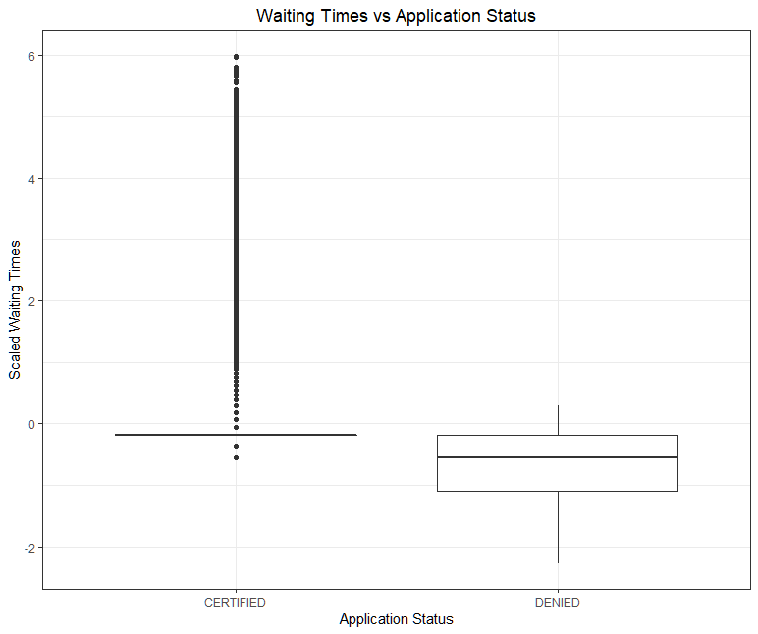
Hypothesis Generation
Validation
Important Predictors | Insight
Pay Unit of the job | More likely to reject applications for ad-hoc jobs
Wage | Applications for high paying jobs should be certified more easily
Submission/Decision | Tendency to deny more for lean application periods
Waiting times for the decision | Rejections should be much quicker than certifications
Job Function Group | Certification depends on the job function that the person applies for.
Notes:
sagar

Slide 9
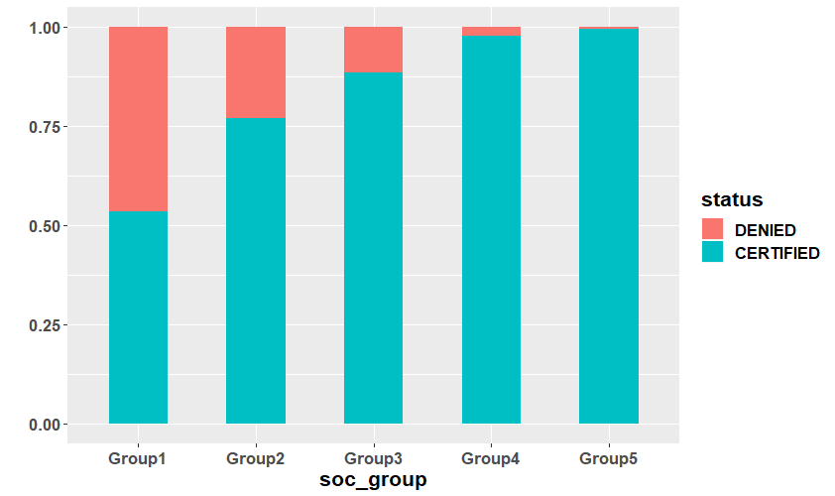
Hypothesis Generation
Validation
Important Predictors | Insight
Pay Unit of the job | More likely to reject applications for ad-hoc jobs
Wage | Applications for high paying jobs should be certified more easily
Submission/Decision | Tendency to deny more for lean application periods
Waiting times for the decision | Rejections should be much quicker than certifications
Job Function Group | Certification depends on the job function that the person applies for.
Job Function Group vs Denial Rate
Notes:
sagar

Slide 10
Data Cleaning
Removed rows with missing data.
Removed data before the year 2016.
Kept rows where visa is H1B.
Added a variable to keep track of waiting times between application submission and decision.
Added a new variable – “wage” that standardizes the wages to yearly.
The job applied for was categorized as STEM or NOT-STEM.
The job function was arranged into groups based on denial rates.
The employment state/worksite state was put into regions – to make it easier to process.
Scaled the wage and waiting times to normalize data.
Notes:
sagar

Slide 11
Predictions

Slide 12
Interpreting Results - Confusion Matrix
Actual | Predictions
 | Denied(+ve) | Certified(-ve)
Denied (+ve) | True Positive | False Negative
Certified (-ve) | False Positive | True Negative
False Negative Rate = False Negative/ (False Negative + True Positive)
False Positive Rate = False Positive/(False Positive + True Negative)
Total Error Rate = (False Positive + False Negative)/(Total)
We want to minimize false negative rate first, then minimize the total error rate.
Notes:
Cory

Slide 13
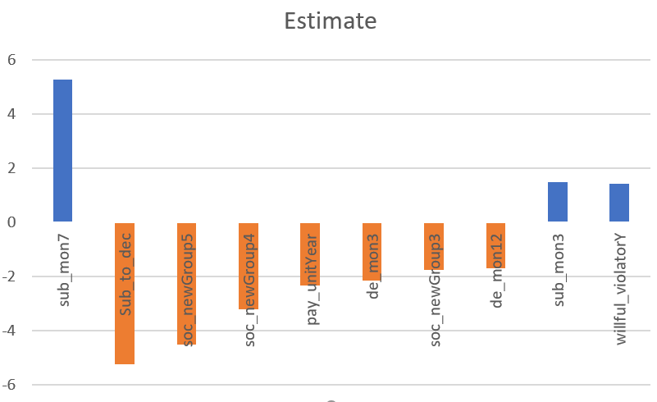
Logistic Regression with stepwise selection
Variables Used-
Status ~ Sub_mon + Dec_mon + Workers + Fulltime + Pay_unit + H1Bdepen + STEM +
Willful_violator + Employer_region + Worksite_region + Sub_to_dec + Wage + Soc_group
Results
Actual | Predictions
 | Denied(+ve) | Certified(-ve)
Denied (+ve) | 206 | 455
Certified (-ve) | 10 | 49,493
Statistic | Value
False Negative Rate | 68.8%
False Positive rate | 0.02%
Total Error Rate | 0.9%
Notes:
tina

Slide 14
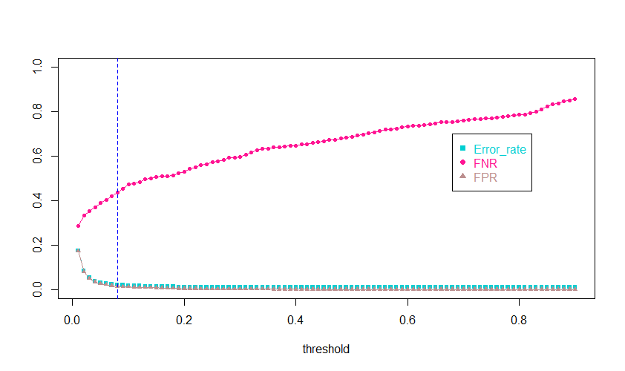

Logistic Regression with threshold selection
From the plot, we choose 0.08 as our threshold for prediction.
If , then we predict it as ‘Denied’.
Threshold Selection
Results
Actual | Predictions
 | Denied(+ve) | Certified(-ve)
Denied (+ve) | 372 | 289
Certified (-ve) | 686 | 48,817
0.08
Statistic | Value
False Negative Rate | 44.7%
False Positive rate | 1.4%
Total Error Rate | 1.9%
Notes:
tina

Slide 15
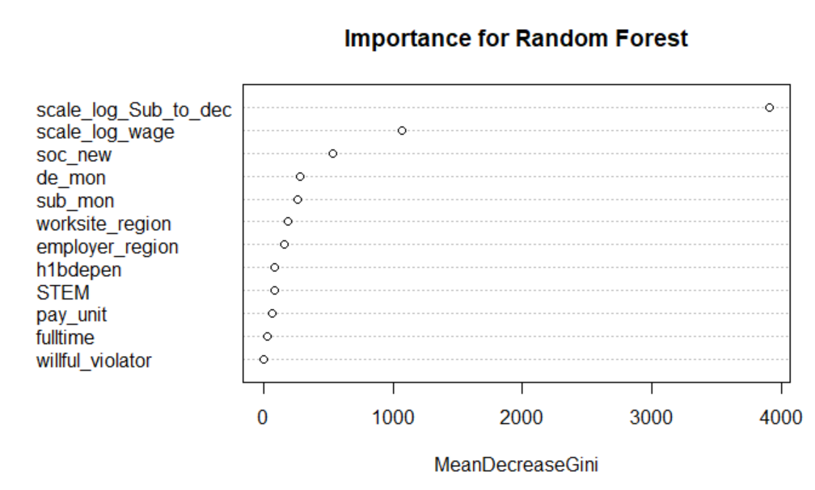
Random Forest
We selected a random forest with 50 trees and 4 predictors per tree.
Variables same as that for logistic regression with backward selection.
Variable Importance Plot
Results
Actual | Predictions
 | Denied(+ve) | Certified(-ve)
Denied (+ve) | 346 | 279
Certified (-ve) | 7 | 49,532
Statistic | Value
False Negative Rate | 44.6%
False Positive rate | 0.01%
Total Error Rate | 0.6%
Notes:
Kirti

Slide 16
Random Forest – Bagging Important Variables
Using the 3 most important variables found in the Random Forest model
We fit a model with 50 bags using the submission-to-decision, wage, and job function variables
Variable Importance Plot
Results
Actual | Predictions
 | Denied(+ve) | Certified(-ve)
Denied (+ve) | 332 | 293
Certified (-ve) | 85 | 49,454
Statistic | Value
False Negative Rate | 46.8%
False Positive rate | 0.17%
Total Error Rate | 0.7%
Notes:
Kirti

Slide 17
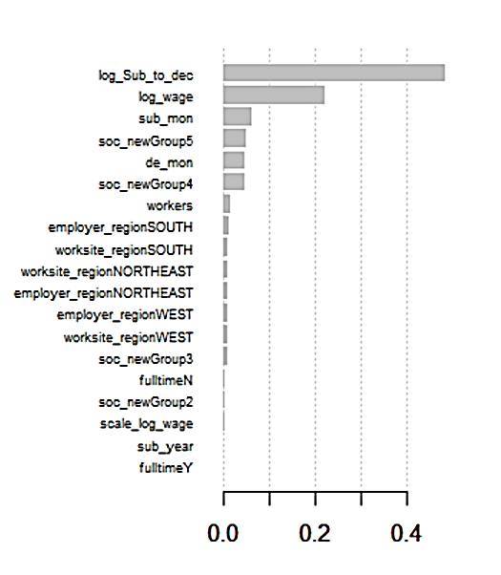
Boosting - XGBoost
Ran boosting with 200 trees with a depth of 10 each.
Lambda value = 0.3
Threshold for certified/denied is 0.05
Variable Importance Plot
Results
Actual | Predictions
 | Denied(+ve) | Certified(-ve)
Denied (+ve) | 421 | 182
Certified (-ve) | 716 | 48,844
Statistic | Value
False Negative Rate | 30.2%
False Positive rate | 1.4%
Total Error Rate | 1.8%
Notes:
kirti

Slide 18
Comparison of Models
Model | False Negative Rate | Total Error Rate
Logistic Regression
Stepwise Selection | 68.8% | 0.9%
With threshold selection | 44.7% | 1.9%
LDA with equal prior probabilities | 41.5% | 17.9%
Random Forest
Without bagging | 44.2% | 0.6%
With bagging (3 variables) | 46.8% | 0.7%
XGBoost | 30.2% | 1.8%
The best model in terms of minimized false negative rate is XGBoost, but we prefer to use the Random Forest model because it has the lowest error rate.
Notes:
Cory

Slide 19
Thank you!

